Slide 1
205, Nov 11, Class 22
Final projects
Start building your procedure online
Ethics 2: Responsible Conduct of Research

Slide 2
Responsible Conduct of Research
Researcher processes with rigor and integrity
Don’t lie, cheat or steal
Data Manipulation
Forgery: fabrication or modification
Data selection
Eliminating all data inconsistent with the hypothesis
Bias in recruiting, protocol administration or data scoring

Slide 3
Analytic Flexibility
File drawer effect
Re-running or re-starting the experiment repeatedly until it “works”
“p-hacking”
Trying different analysis approaches until it “works”
Normal processes that seem similar
Pilot testing
Data exploration
Standard exclusion/filtering processes
When is it too much?

Slide 4
Reproducibility
Research that meets the p<.05 statistical criterion should replicate if repeated
Except for power issues or generalizability questions
Weak processes for research rigor make this less likely
Even typical lab processes risk inflating the estimated effect size
Replication crisis approaches
More rigor, fewer studies with greater confidence
More studies without increasing rigor, build in replications

Slide 5
Plagiarism
Citation strengthens reports
Novel findings have value
Build on existing ideas
Actual appropriation of others’ ideas
Scooping other labs
Pre/re publishing manuscripts
Authorial credit to collaborators and research team
Significant intellectual contribution
Definition varies across psychology, medicine for example
Not uncommon source of in-laboratory friction

Slide 6
Being Public
All aspects of the research process are auditable
Participant privacy must still be protected
Researchers protected from exposure to competing labs
Patent, copyright, and invention privacy
Publication
Full, fair & accurate reporting, making all resources available
Not always practically effective
Supplementary materials via journal website
Public availability of de-identified data
Does not always include excluded data

Slide 7
RCR Errors
Suppose a friend doing a research project said to you, “I’m sure my hypothesis is correct, so I’ll just give my participants a hint here and there to make sure the data come out properly.”
1. What kind of RCR violation is this?
2. What methodological approach should be used by this research to avoid this problem?

Slide 8
RCR Errors
In a study of marriage relationships, a researcher discovers that one of the participants in the study is an acquaintance and has indicated ‘yes’ to the question of having had an extra-marital affair. The researcher is debating whether they should inform the participants’ spouse.
3. What kind of research ethics violation is being considered here? What should they do?

Slide 9
RCR Errors
A researcher doing a study on academic performance of students who have been diagnosed with ADHD. Some of the potential participants have refused to answer the question about their diagnosis, so the researcher contacts their medical provides without the participant’s knowledge.
4. What kind of research ethics violation has occurred here?

Slide 10
Intervention research
5. Give an example of a research study not included in the chapter for which it would be unethical to include a placebo/control group.

Slide 11

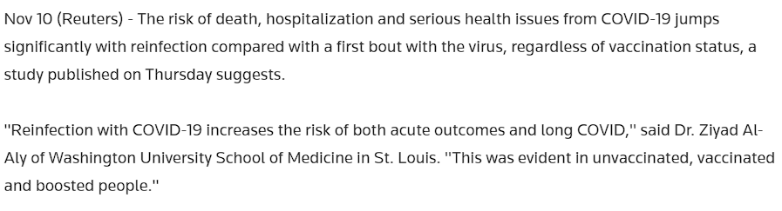

Slide 12
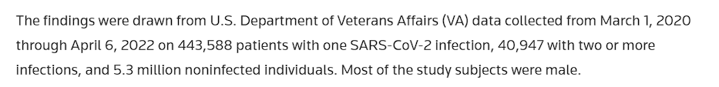
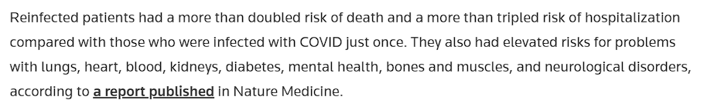
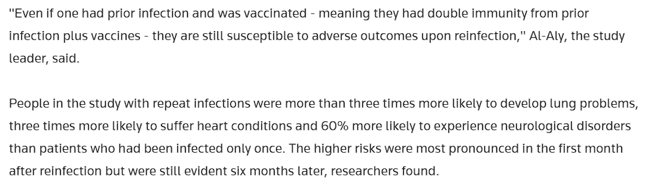

Slide 13
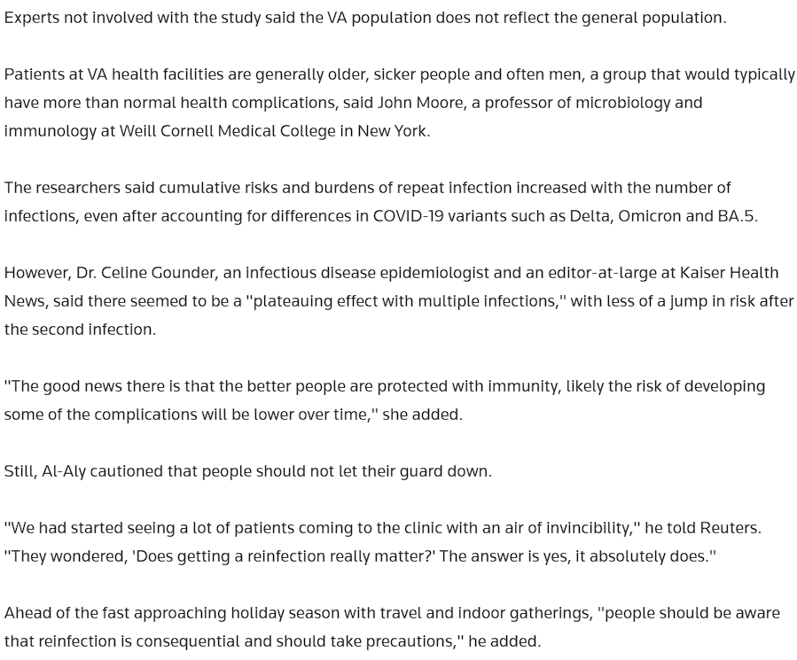

Slide 14
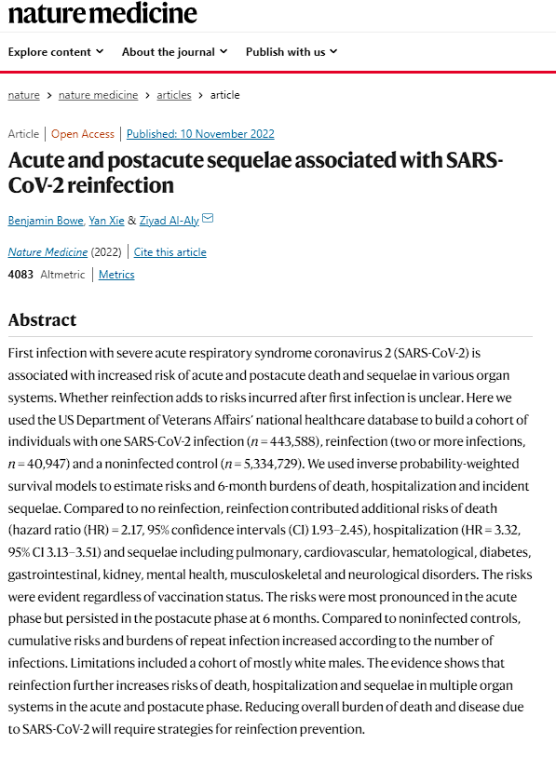
Key contrast
Re-infected versus one case not re-infected
What cannot be controlled properly in this non-experimental study?

Slide 15
Philosophical Ethical Challenges
When the experimental treatment is a benefit
Justice would normally mean equal benefits across groups
Intervention research on Monday
Coercion versus voluntary participation
Authority figures: supervisors, teachers
Financial rewards: incentivizing risk
Vulnerable populations
Children: depend on guardian
Mandatory reporting training for staff
Prisoners: cannot voluntarily consent
Research must be for prisoners’ benefit

Slide 16
For Mon 11/14
Chapter 19: Quasi-experimental design
Intervention research
Wednesday, Chapter 20
Developmental psychology and Neuropsychology
Friday, Exam 2
Project presentations during Thanksgiving week on zoom

